Slide 1

Predicting charge time of an electric vehicle Using Machine Learning Techniques
Submitted by
K N S S Jayaram
(AP21110020005)
K Trinadh Sundar
(AP21110020034)

Slide 2
Introduction
A smart grid system is an advanced and digitally enhanced electricity distribution and management system.
It incorporates modern technologies and communication capabilities to improve the efficiency, reliability, flexibility, and sustainability of the electric grid.
Smart grids support the charging of electric vehicles (EVs). They optimize charging times to balance electricity demand, support fast charging, and enable vehicle-to-grid (V2G) capabilities where EVs can feed electricity back into the grid.
As EV use has increased, several problems have arisen, including the requirement to build a charging infrastructure, and forecast peak loads.

Slide 3
Introduction
G2V (Grid-to-Vehicle):
G2V, or grid-to-vehicle, refers to the process of transferring electricity from the power grid to electric vehicles (EVs) for charging. This can be done using a variety of technologies, such as direct current (DC) fast chargers, smart charging systems, and vehicle-to-grid (V2G) technology.
V2G (Vehicle-to-Grid):
V2G, or vehicle-to-grid, refers to the process of using EVs to store electricity and then discharging it back into the power grid when needed. This can help to balance the grid, reduce peak demand, and even provide ancillary services to the grid operator.
In simple terms, G2V is about charging EVs from the grid, while V2G is about using EVs to charge the grid.

Slide 4
Challenges on power grid
The increasing adoption of electric vehicles (EVs) poses a significant challenge to the power grid. As more EVs are put on the road, the demand for electricity is expected to increase significantly. This can lead to peak loads, voltage fluctuations, and power losses, which can strain the power grid and potentially cause disruptions.
To address this challenge, it is important to be able to predict EV charging time accurately. This information can be used to optimize charging schedules, manage peak loads, and improve the overall efficiency of the power grid.
This operation reduces the expenses associated with charging, high voltages, load fluctuation, and power loss. The effectiveness of various machine learning (ML) approaches is evaluated and compared.

Slide 5
Dataset
Dataset Link: https://www.kaggle.com/datasets/michaelbryantds/electric-vehicle-charging-dataset
This dataset consists of 3000 samples and is used for training and evaluation
There are almost 9 features and one column represents the target variable(Charge Time)
This dataset is used to predict the charging time of an electric vehicle by the 9 features in the dataset using different ML techniques

Slide 6
Features in Dataset
Session ID
Cost
Start Time
End Time
User ID
Location ID
Station ID
Week day
Charge Time

Slide 7
Methodology
Decision Tree: It is a Supervised learning technique that can be used for both classification and Regression problems. They employ a hierarchical structure resembling a tree, where each internal node represents a feature, each branch a decision based on that feature, and each leaf node a final output or prediction.
Random Forest: Random Forests are a popular choice for regression tasks due to their ability to handle complex data, reduce overfitting, and provide reliable predictions by aggregating the outputs of multiple decision trees.
SVM: Support Vector Machine or SVM is one of the most popular Supervised Learning algorithms, which is used for Classification as well as Regression problems. SVMs are particularly good at solving binary classification problems, which require classifying the elements of a data set into two groups.

Slide 8
Methodology
Gradient Boosting: It is a popular boosting algorithm in machine learning used for classification and regression tasks. Boosting is one kind of ensemble learning method which trains the model sequentially and each new model tries to correct the previous model. It combines several weak learners into strong learners.
K-Nearest Neighbours: K-Nearest Neighbour is one of the simplest Machine Learning algorithms based on Supervised Learning technique. K-NN algorithm can be used for Regression as well as for Classification.

Slide 9
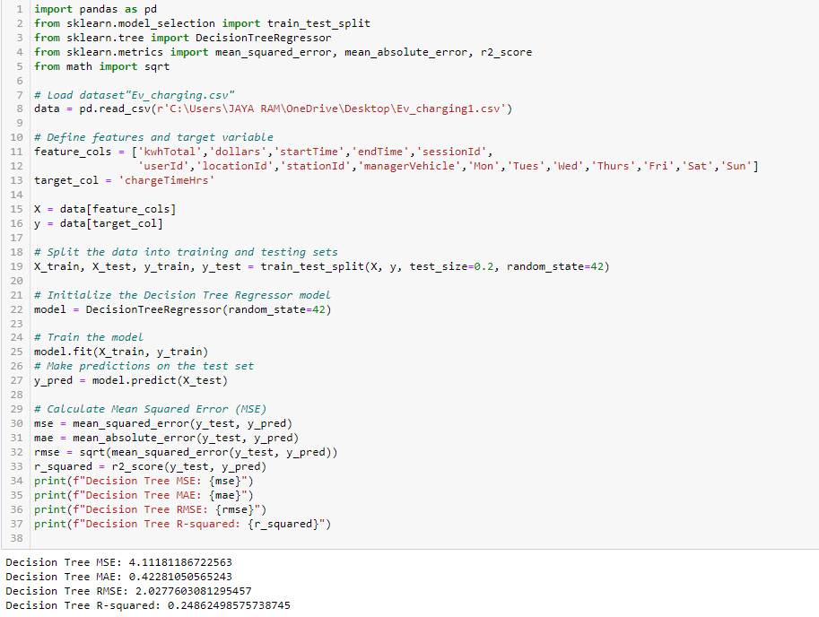
Decision Tree code

Slide 10
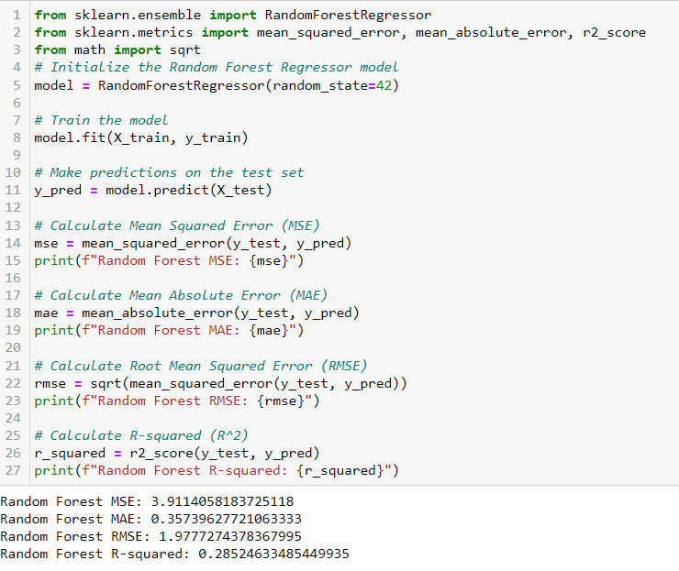
Random Forest code

Slide 11
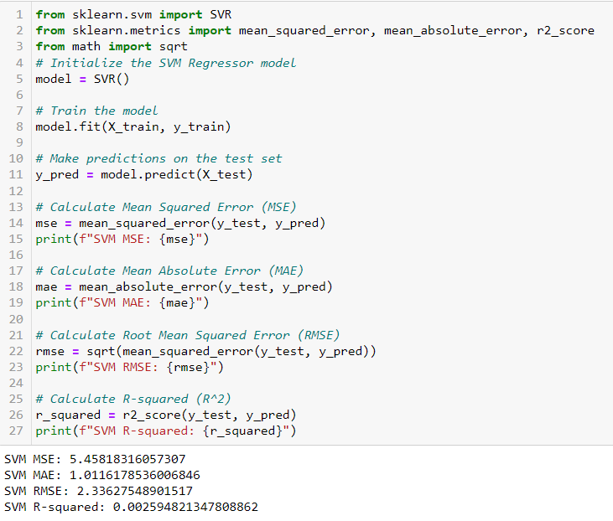
SVM code

Slide 12
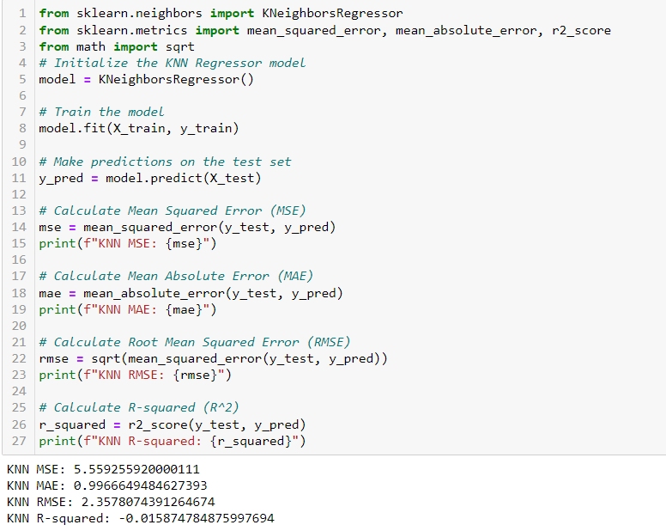
KNN code

Slide 13
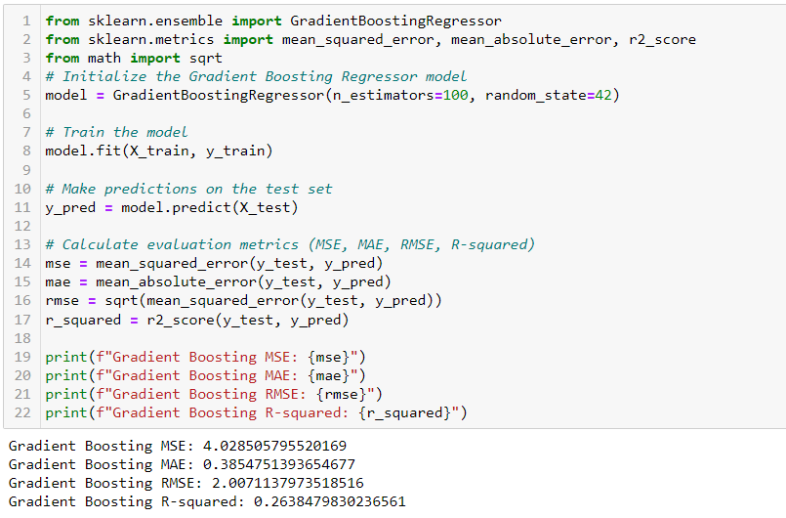
Gradient Boosting code

Slide 14
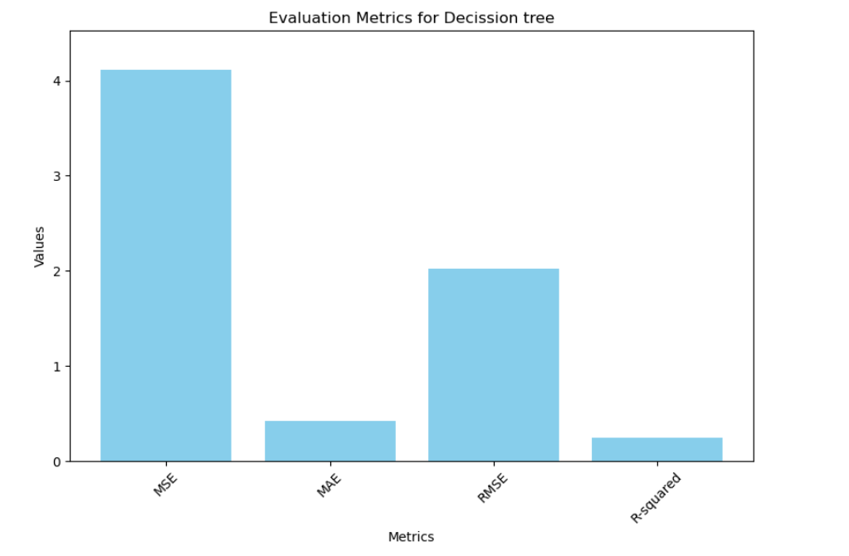
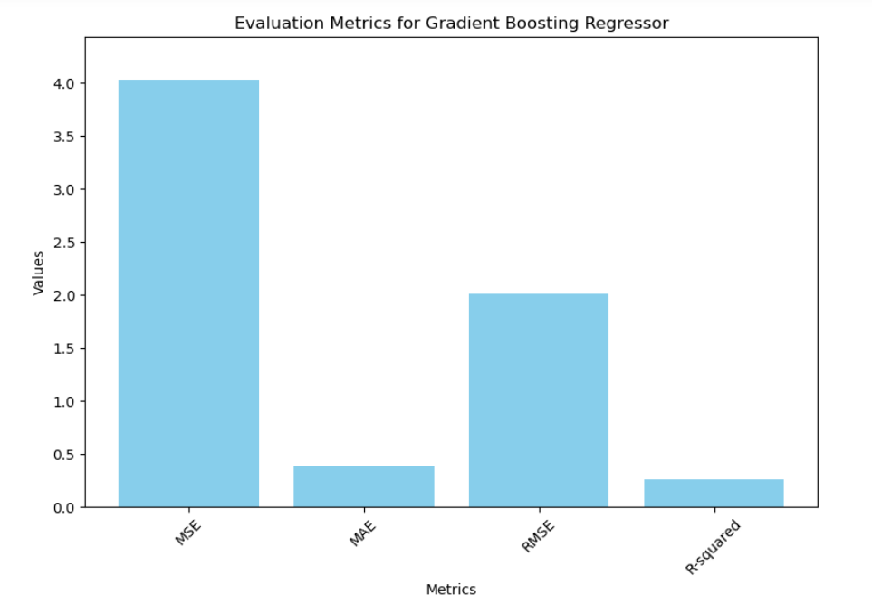
Results

Slide 15
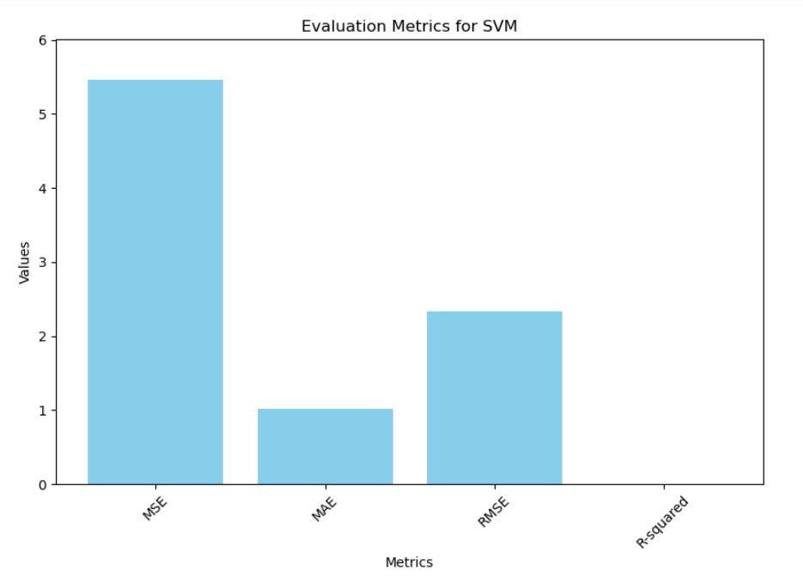
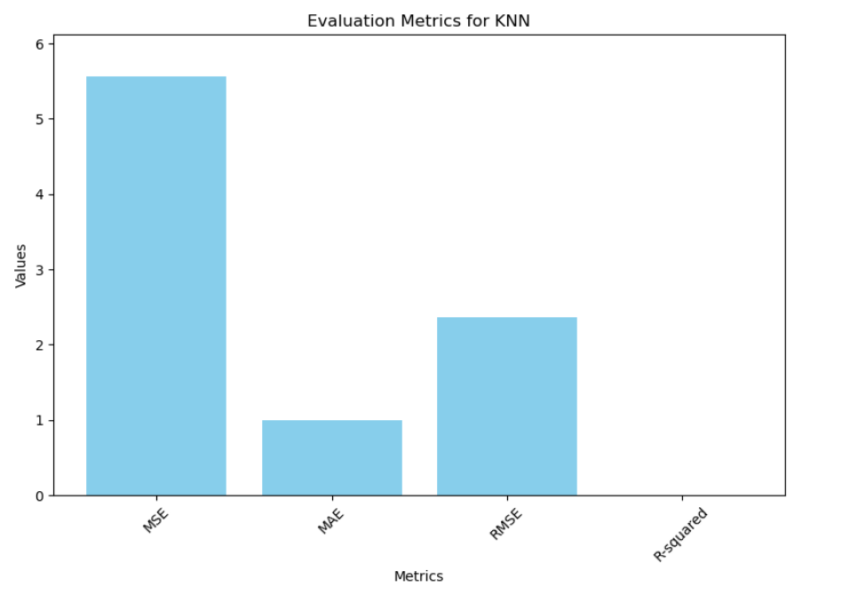
Results

Slide 16
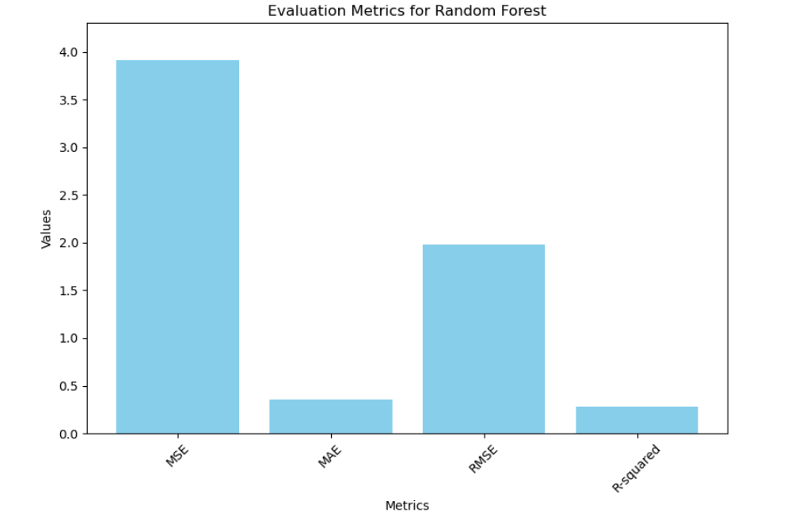
Results

Slide 17
Results
Regression | Decision Tree | Random forest | SVM | KNN | Gradient Boosting
MSE | 4.11181186722563 | 3.9114058183725118 | 5.45818316057307 | 5.559255920000111 | 4.028505795520169
MAE | 0.42281050565243 | 0.35739627721063333 | 1.0116178536006846 | 0.9966649484627393 | 0.3854751393654677
RMSE | 2.0277603081295457 | 1.9777274378367995 | 2.33627548901517 | 2.3578074391264674 | 2.0071137973518516
R-Squared | 0.24862498575738745 | 0.28524633485449935 | 0.002594821347808862 | -0.015874784875997694 | 0.2638479830236561

Slide 18
Conclusion
With this we say that for a classifier if the accuracy is more then it is the best. But for a regressor we need to consider MSE,MAE,RMSE,R-squared
Random Forest and Gradient Boosting have relatively lower MSE, RMSE, and higher R-squared compared to other models, indicating better performance in this scenario.
KNN has the highest MSE and RMSE and a negative R-squared, which suggests that this model might not fit the data well compared to the others.
SVM is giving a near-zero R-squared, which implies it may not capture the variability in the data effectively.

Slide 19


